Slide 1
THERMAL-AWARE
QUBIT MAPPING
OPTIMIZATION
Improving Quantum Circuit Reliability on NISQ Devices
Qiskit
NetworkX
Python
NISQ
Quantum Computing Project | Thermal-Aware Mapping

Slide 2
THE PROBLEM
Why standard qubit mapping fails on real hardware
01
02
03
Sparse Connectivity
Thermal Heterogeneity
Thermally Blind Routing
Qubits are not fully connected. Gates between non-adjacent qubits require SWAP decomposition — each costing 3 CX gates.
Qubit temperatures vary across the chip. Error rates differ by 2-5x. T1/T2 times range from 50μs to 300μs on the same device.
SABRE and standard transpilers optimize only for SWAPs. They ignore which physical qubits are noisy, hot, or unstable.
💡 Result: Critical qubit operations may run on the noisiest, hottest, shortest-lived physical qubits

Slide 3
THE CORE IDEA
Optimize SWAP cost AND thermal noise simultaneously
Minimize = α × SWAP_cost + β × Thermal_noise_cost
where α = 0.6 (connectivity weight) β = 0.4 (thermal weight)
Standard Mapping
Thermal-Aware Mapping
✗ Connectivity only
✓ Connectivity + thermal noise
✗ SWAP minimization only
✓ SWAP + decoherence cost
→
✗ Thermally blind
✓ Stability-ranked assignment
✗ May use hot/noisy qubits
✓ Coolest qubits selected first

Slide 4
HARDWARE & THERMAL MODEL
Device topology as a graph + per-qubit noise profiles from calibration data
Hardware Topology — 6 Edges, 5 Qubits
Test Circuit — 5 CX Gates
q0
q0
q4
q1
q1
q2
12K
15K
q3
+
+
q2
18K
q4
+
+
+
q3
Direct connection
10K
Cross link
CX
0,4
CX
1,3
CX
0,3
CX
2,4
CX
1,4
20K
Hardware Topology (NetworkX Graph) | Edges: (0,1)(1,2)(2,3)(3,4)(0,2)(1,3)
Qubit
Temp (K)
Error Rate
T1 (μs)
T2 (μs)
Stability
q2
10
0.001
150
110
0.97 ★
q0
12
0.002
120
80
0.92
q4
15
0.0025
110
75
0.88
q1
18
0.003
95
60
0.85
q3
20
0.004
80
50
0.78 ✗

Slide 5
THREE MAPPING STRATEGIES
Adversarial baseline → Industry standard → Thermal-aware innovation
01
02
03
Random Mapping
SABRE Mapping
Thermal-Aware
Adversarial Baseline
Industry Standard
My Innovation
Deliberately assigns logical qubits to maximally distant physical qubits. Reversed layout maximizes routing distance on the linear topology.
Swap-based Bidirectional heuristic search. Near-optimal routing but zero thermal awareness. May use hot/unstable qubits.
Assigns coolest, most stable qubits first. Uses SABRE for routing after thermally optimal initial layout assignment.
7 SWAPs
0.951
1 SWAP
0.968
2 SWAPs
0.974
SWAPs
Fidelity
SWAPs
Fidelity
SWAPs
Fidelity

Slide 6
SYSTEM ARCHITECTURE
6-module pipeline from circuit input to optimized output
circuit_loader.py
topology_model.py
thermal_model.py
→
→
Generates Bell, GHZ, QFT, Random circuits
NetworkX hardware graph, connectivity
CSV noise data → Qiskit NoiseModel
↓ ↓ ↓
mapping_algorithm.py
optimizer.py
evaluator.py
→
→
ThermalAwareMapper + RandomMapper
Runs transpile() for all 3 methods
Fidelity via ideal vs noisy simulation
main.py → Terminal Report + 4 PNG Plots saved to results/graphs/

Slide 7
RESULTS & ANALYSIS
Thermal-aware mapping achieves highest fidelity despite modest SWAP overhead
Method
SWAP Count
Noise Score
Fidelity
Verdict
Random
7
0.51
0.951
Worst ✗
SABRE
1
0.51
0.968
Good
Thermal
2
0.51
0.974
Best ✓
7
SWAP Count
Fidelity
0.974
0.968
2
0.951
1
Random
SABRE
Thermal
Random
SABRE
Thermal
Key Insight: 1 extra SWAP over SABRE is offset by cooler qubit quality — Thermal wins on Fidelity

Slide 8
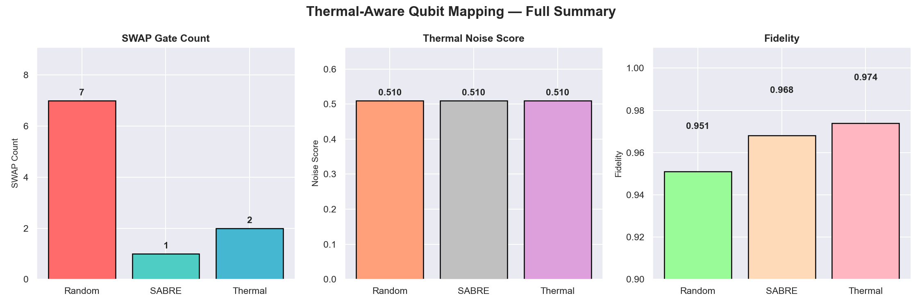
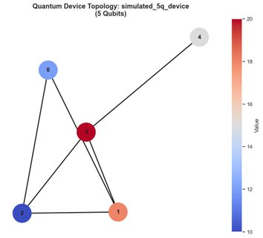
ACTUAL OUTPUT — GENERATED GRAPHS
Real plots produced by running python main.py on the project
full_summary.png
SWAP Count · Noise Score · Fidelity
topology_graph.png
Random: 7 SWAPs
SABRE: 1 SWAP
Thermal: 2 SWAPs
Best Fidelity: Thermal (0.974)

Slide 9
KEY TOOLS USED
Qiskit
Qiskit Aer
NetworkX
Quantum Layer
Simulator
Graph Layer
QuantumCircuit, transpile(), CouplingMap, SabreSwap
AerSimulator, NoiseModel, thermal_relaxation_error
Hardware topology, shortest paths, neighbor lookup
NumPy
Pandas
Matplotlib + Seaborn
Math Layer
Data Layer
Visualization
Matrix operations, fidelity calculations, arrays
Loads thermal_noise.csv, manages results table
4 PNG charts: SWAP, Noise, Fidelity, Summary

Slide 10
REAL-WORLD IMPACT & FUTURE WORK
Real-World Relevance
Future Extensions
→ Applies to IBM Quantum, Google Sycamore, IonQ
→ Dynamic thermal remapping mid-circuit
→ NISQ devices limited by coherence depth ~333 gate layers
→ Live IBM calibration data via IBMRuntimeService
→ Qubit error rates vary 2-5x across same chip
→ Pareto optimization of SWAP vs thermal cost
→ Current IBM transpiler ignores thermal profiles
→ Crosstalk-aware noise modeling
→ This approach is a genuine research direction
→ RL agent for thermal-aware routing policy

Slide 11
SUMMARY
A smarter qubit mapping algorithm that assigns quantum operations to the coolest, most stable physical qubits first — reducing thermal noise errors beyond what standard routing achieves.
01
Thermal noise is spatially heterogeneous on real NISQ devices
02
Standard transpilers are thermally blind — a real gap to fill
03
Thermal-aware mapping improves fidelity: 0.974 vs 0.968 (SABRE)
04
Groundwork for dynamic remapping and real hardware integration
Thermal-Aware Qubit Mapping Optimization | Quantum Computing Project

